Slide 1
Finding Clusters of Environmental Disease Under S. 76
Testimony of Richard B Belzer
Committee on Environment and Public Works U. S. Senate
“Oversight Hearing on Disease Clusters and Environmental Health”
March 29, 2011

Slide 2
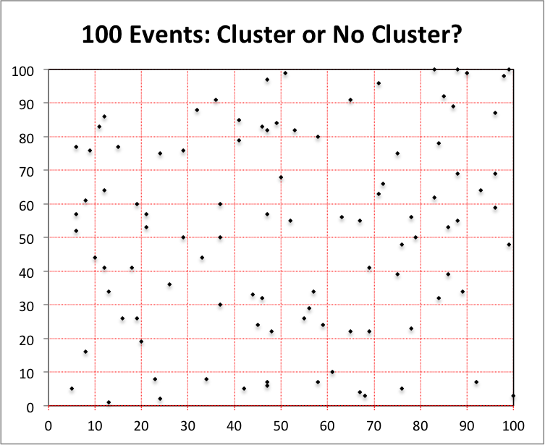
Chart 1: 100 Observed Disease Cases

Slide 3
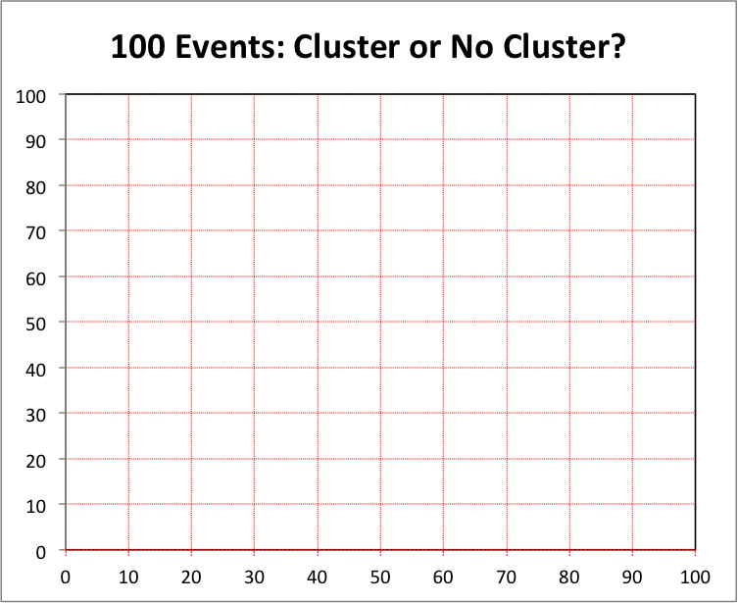
Chart 2: Blocks with Expected Number of Cases Highlighted
0
0
0
1
1
1
1
1
3
3
0
2
0
1
4
2
0
0
1
1
2
1
2
0
1
0
0
1
1
0
1
2
0
1
0
1
0
2
2
2
2
0
3
1
1
1
2
2
2
1
0
3
0
1
0
0
1
1
0
1
0
1
1
1
2
1
0
1
3
0
0
2
0
0
2
3
2
1
0
0
1
0
1
0
0
0
1
0
0
0
1
1
2
1
3
1
2
1
0
2

Slide 4
Chart 2: Blocks with 4x Expected Number of Cases Highlighted
0
0
0
1
1
1
1
1
3
3
0
2
0
1
4
2
0
0
1
1
2
1
2
0
1
0
0
1
1
0
1
2
0
1
0
1
0
2
2
2
2
0
3
1
1
1
2
2
2
1
0
3
0
1
0
0
1
1
0
1
0
1
1
1
2
1
0
1
3
0
0
2
0
0
2
3
2
1
0
0
1
0
1
0
0
0
1
0
0
0
1
1
2
1
3
1
2
1
0
2

Slide 5
Chart 2: Blocks with 3-4x Expected Number of Cases Highlighted
0
0
0
1
1
1
1
1
3
3
0
2
0
1
4
2
0
0
1
1
2
1
2
0
1
0
0
1
1
0
1
2
0
1
0
1
0
2
2
2
2
0
3
1
1
1
2
2
2
1
0
3
0
1
0
0
1
1
0
1
0
1
1
1
2
1
0
1
3
0
0
2
0
0
2
3
2
1
0
0
1
0
1
0
0
0
1
0
0
0
1
1
2
1
3
1
2
1
0
2

Slide 6
Chart 4: Blocks with 3-4x Expected Number of Cases Highlighted
0
0
0
1
1
1
1
1
3
3
0
2
0
1
4
2
0
0
1
1
2
1
2
0
1
0
0
1
1
0
1
2
0
1
0
1
0
2
2
2
2
0
3
1
1
1
2
2
2
1
0
3
0
1
0
0
1
1
0
1
0
1
1
1
2
1
0
1
3
0
0
2
0
0
2
3
2
1
0
0
1
0
1
0
0
0
1
0
0
0
1
1
2
1
3
1
2
1
0
2

Slide 7
Chart 5: Blocks with 2-4x Expected Number of Cases Highlighted)
0
0
0
1
1
1
1
1
3
3
0
2
0
1
4
2
0
0
1
1
2
1
2
0
1
0
0
1
1
0
1
2
0
1
0
1
0
2
2
2
2
0
3
1
1
1
2
2
2
1
0
3
0
1
0
0
1
1
0
1
0
1
1
1
2
1
0
1
3
0
0
2
0
0
2
3
2
1
0
0
1
0
1
0
0
0
1
0
0
0
1
1
2
1
3
1
2
1
0
2

Slide 8
Chart 6: Blocks Meeting Definition in S. 76 § 5(4)(A)
0
0
0
1
1
1
1
1
3
3
0
2
0
1
4
2
0
0
1
1
2
1
2
0
1
0
0
1
1
0
1
2
0
1
0
1
0
2
2
2
2
0
3
1
1
1
2
2
2
1
0
3
0
1
0
0
1
1
0
1
0
1
1
1
2
1
0
1
3
0
0
2
0
0
2
3
2
1
0
0
1
0
1
0
0
0
1
0
0
0
1
1
2
1
3
1
2
1
0
2

Slide 9
Chart 7: Blocks Meeting Definition in S. 76 § 5(4)(A)-(B)
0
0
0
1
1
1
1
1
3
3
0
2
0
1
4
2
0
0
1
1
2
1
2
0
1
0
0
1
1
0
1
2
0
1
0
1
0
2
2
2
2
0
3
1
1
1
2
2
2
1
0
3
0
1
0
0
1
1
0
1
0
1
1
1
2
1
0
1
3
0
0
2
0
0
2
3
2
1
0
0
1
0
1
0
0
0
1
0
0
0
1
1
2
1
3
1
2
1
0
2

